Slide 1


Internship Presentation
After Sales Analytics in Automobile Industry
Date : 10.07.2022
Group Number : 3A
Team Members: AYUSH KUMAR PATI, SONAL RAJ SINGH, SATARTHA MOHANTY, MEENAKHI SENAPATI , GUPTA DAMI , D SHIVA SATHWIK, JAGANNATH KAR , SK MD SAMIM AKHTAR, SIBASANKAR SWAIN

Slide 2
Topics to be Covered
Section
Presentation Flow
Slide No.
1
Automobile Industry - Background
3
2
How Sales Happen in Automobile Industry
4
3
How is Data Analytics helpful in monitoring Sales in Automobile Industry
5
4
Key KPIs in Sales Analytics
6
5
Sample Dashboards depicting Sales Analytics in Automobile Industry
7
6
Conclusion
8

Slide 3
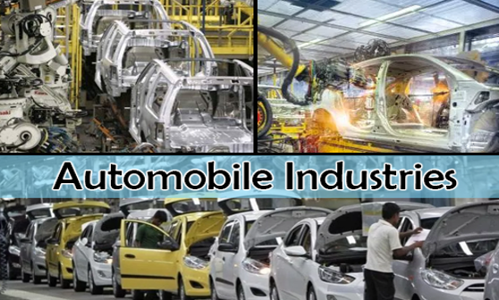
Automobile Industry – Background
Growing energy demand and exploration of new conventional and non-conventional hydrocarbon resources are fueling the growth of the segment.
The sector can witness explosive growth in nanotechnology and nano-scale assembly systems; MEMS and nanotech sensors (tiny, low-power, low-cost sensors) which can measure everything and anything.​
Huge potential is seen in Robotics. India has low robot density figures, only four industrial robots per 10,000 employees in the manufacturing industry. ​
The automation market in India has been growing significantly over the last decade due to the increasing need for reliable and cost-effective ways of production.​
The Indian industrial automation industry is expected to reach 197 billion by 2020 with growth driven by the rapid adoption of modern technology backed by cost-saving features.​

Slide 4
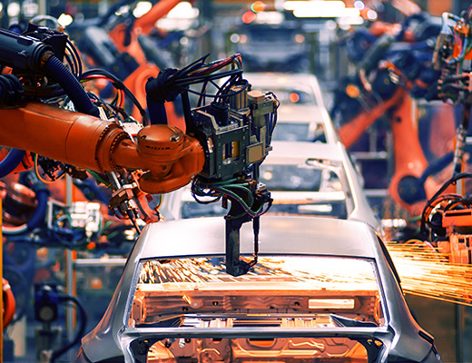
How Sales Happen in Automobile Industry
The automobile industry is dependent on various factors such as availability of skilled labour at low cost, robust R&D centres, and low-cost steel production. The industry also provides great opportunities for investment and direct and indirect employment to skilled and unskilled labour.
Indian automotive industry (including component manufacturing) is expected to reach Rs. 16.16-18.18 trillion (US$ 251.4-282.8 billion) by 2026.
The Indian auto industry is expected to record strong growth in 2022-23, post recovering from effects of COVID-19 pandemic. Electric vehicles, especially two-wheelers, are likely to witness positive sales in 2022-23.

Slide 5
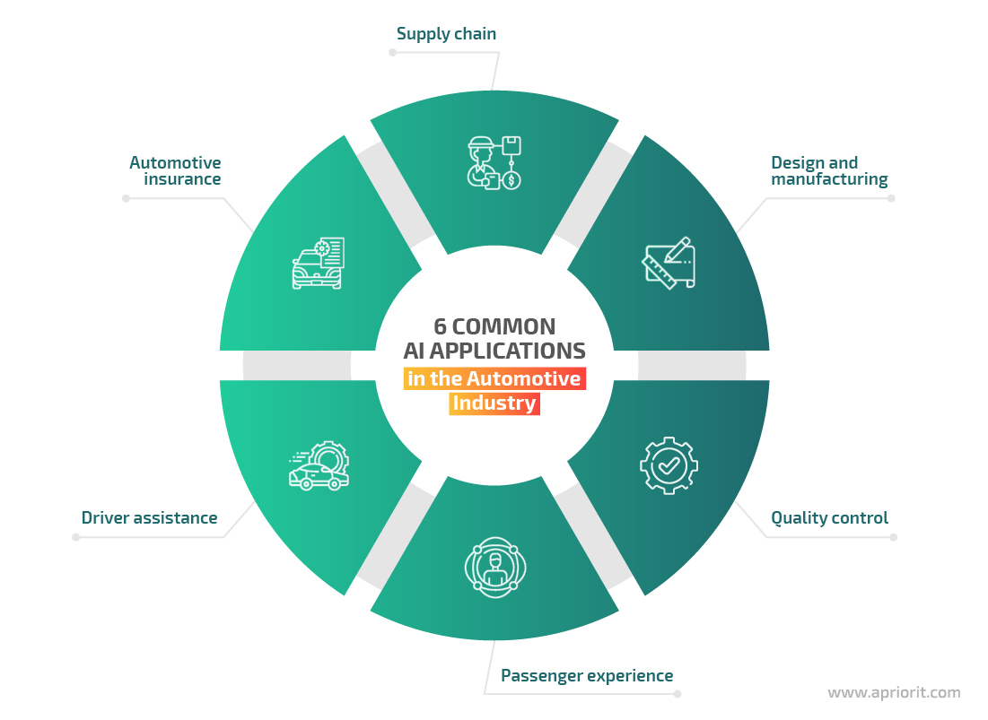
How is Data Analytics helpful in monitoring Sales in Automobile Industry
Big data analytics forms the basis of all other applications as large chunks of information are being gathered and organised for use.
Major use cases include changing the automotive business, supporting mechanization, and boosting automation.
In addition to this, the effective utilization of big data is assisting automotive players in exploring newer ideas and using materials having extraordinary advantages as compared to those earlier. This big step will not only help in tremendous expense reduction but also lead to better vehicle quality.
Manufacturing safer and superior quality vehicles requires a data-driven approach. Data science can lead to better mobility solutions with more connected and autonomous vehicles.

Slide 6
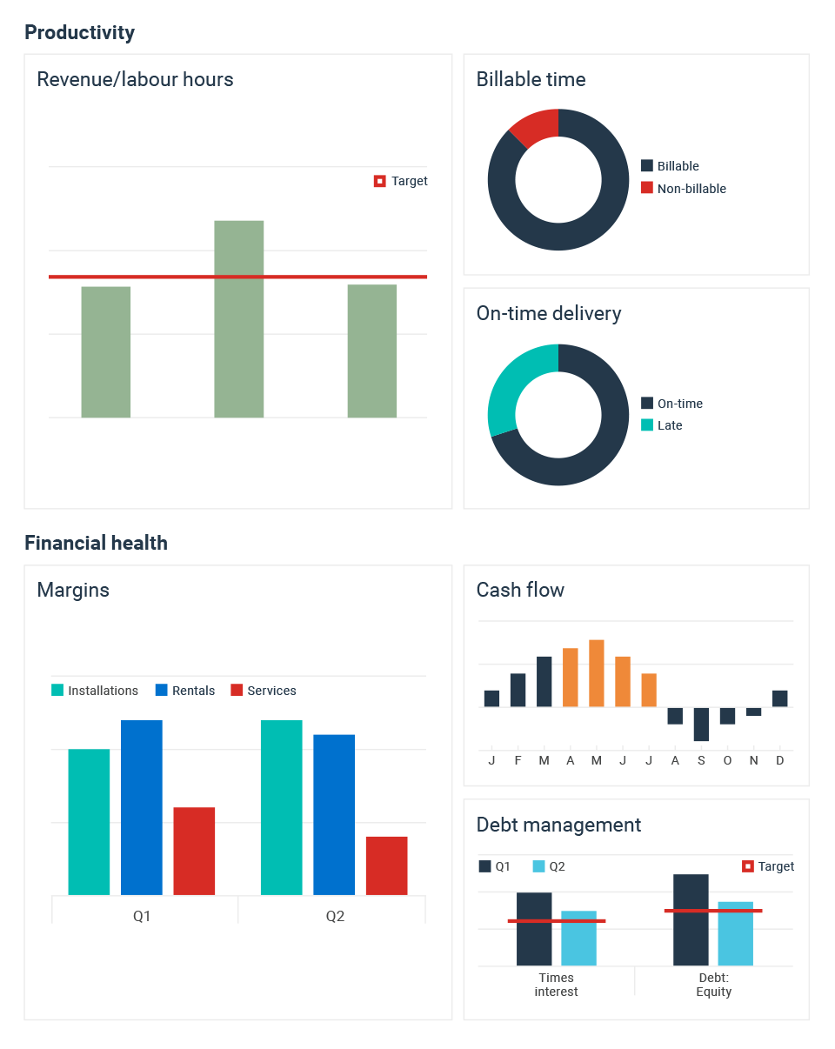
Key KPIs in Sales Analytics

Slide 7
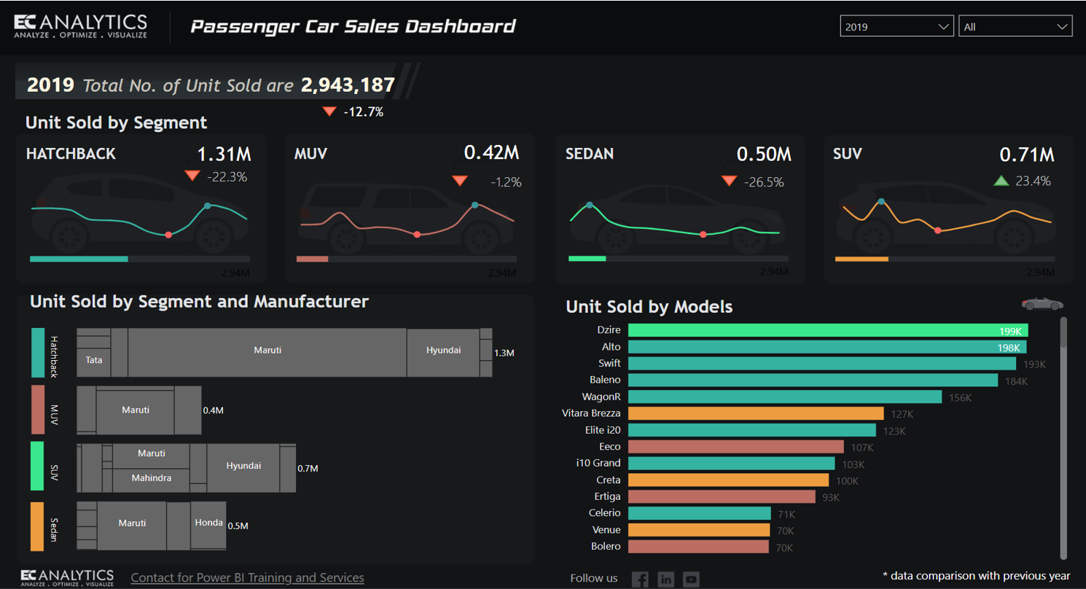
Sample Dashboards depicting Sales Analytics in Automobile Industry

Slide 8
Conclusion
The automobile industry is one of the most important drivers of the economic growth of India and one with high participation in global value chains. The growth of this sector has been on the back of strong government support which has helped it carve a unique path among the manufacturing sectors of India.
The automobiles produced in the country uniquely cater to the demands of low- and middle-income groups of the population which makes this sector stand out among the other automobile-producing countries.
The automobile industry is one of the high performing industries of Indian economy. This has contributed largely in making India a prime destination for many international players in the automobile industry who wish to set up their businesses in India.
By analyzing the current trend of Automobile production and export trend, we can say that the future of automobile industry is bright.

Slide 9
Thank You !!

